Slide 1
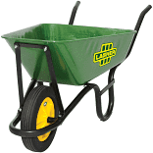

Basic building and plastering tools.
1. Wheelbarrow
- It is used for loading and mixing materials.
2. Measuring Tape
- It is used to measure shorter or longer distances.

Slide 2
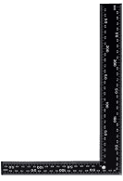
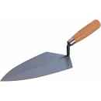
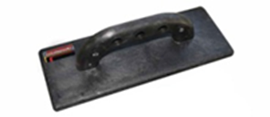
3. Engineer's Square
- It is used for checking square. (internal & external right angles)
4. Trowel
- It is used for laying mortar. - It is used plastering walls

Slide 3
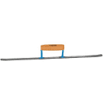
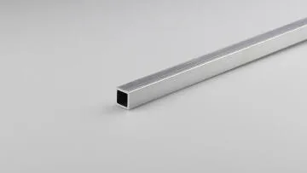
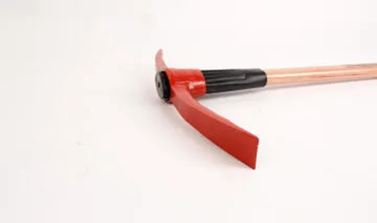
5. Joiner, cross brick
- It is used to finish horizontal and vertical joints between the brick course.
6. Building profile pipe
- It is used to provide accurate guideline when building walls.
7. Pick axe
- It is used for digging trenches.

Slide 4
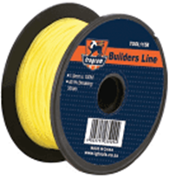

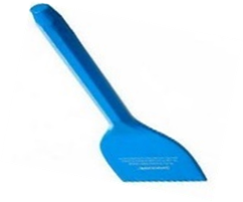
8. Fishing line
- It is used for level of brick coarse or walls.
9. White wash brush
- It is used for wetting surfaces
10. Chisel
- It is used as a cutting tool on bricks and concretes.

Slide 5
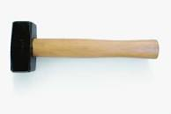
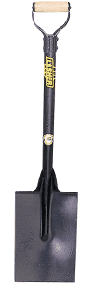
11. Hammers
- It is used for general hammering in brickworks.
12. Shovel
- It is used for digging, moving sands etc.
Video:
https://youtu.be/sGNbsZbbefo?si=CCKmo6qc41d60ClE
Feedback : Activity

Slide 6



Kwa Thema Skills School
Subject : Maintenance Marks: 10
Grade : Year 1 Time : 30 mins
Date : / / 2024
Question:1
1. Name the following marking and cutting hand tools.
1.__________________ 2.______________________
3.___________________ 4. ______________________

Slide 7


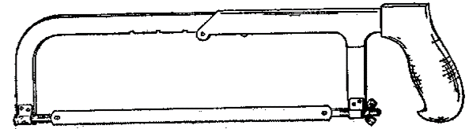
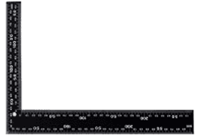
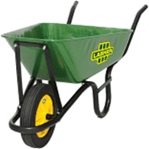
5. _________________ 6. ____________________
7. __________________ 8. ___________________
9. __________________ 10. ___________________
(10)

Slide 8
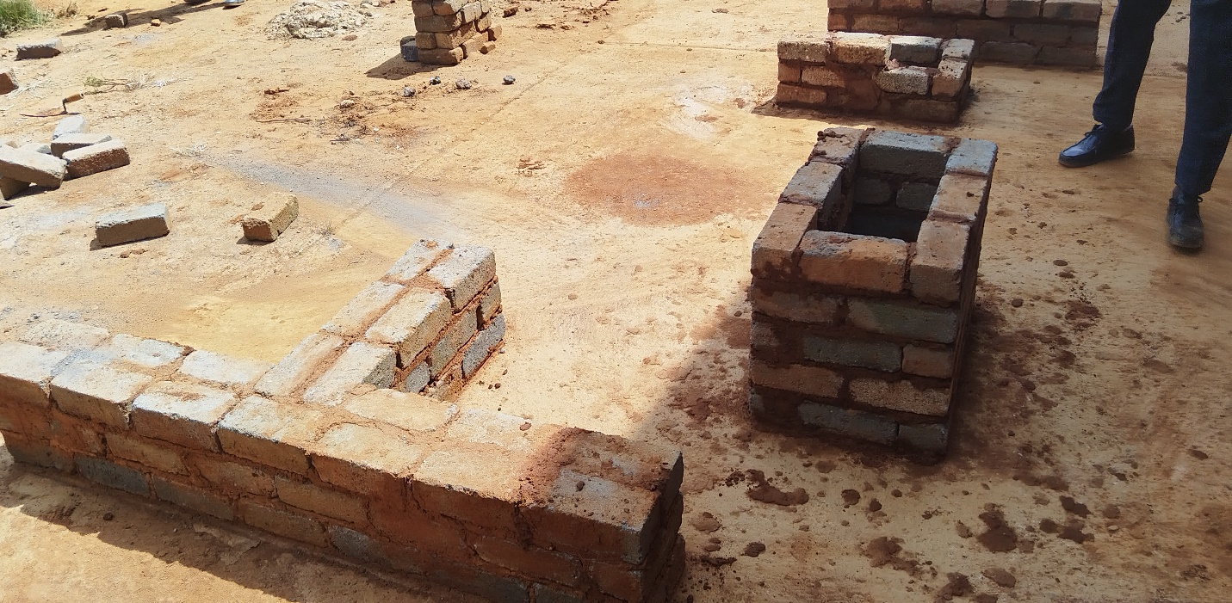
Feedback : Activity
(Practical lesson or Project)
Building Four Coarse Walls

